Slide 1
Introduction to Tecnology
CEIS101
Johnathan Shoff

Slide 2
Basic Circuit

Slide 3
Code to make LED blink

Slide 4
Inventory of IoT Kit
UCTRONICS Kit
ESP32 (2)
LCD Modules (2)
Breadboards (3)
Mini Router
Patch Cable
Digital Multi Meter
USB to Micro USB (2)

Slide 5
Organization of Project Components
Arduino Mega 2560
Breadboard
Resistor 10kΩ
LEDs
Ultrasonic Sensor
Active Buzzer
Photoresistor
Wires
USB Type B cable

Slide 6
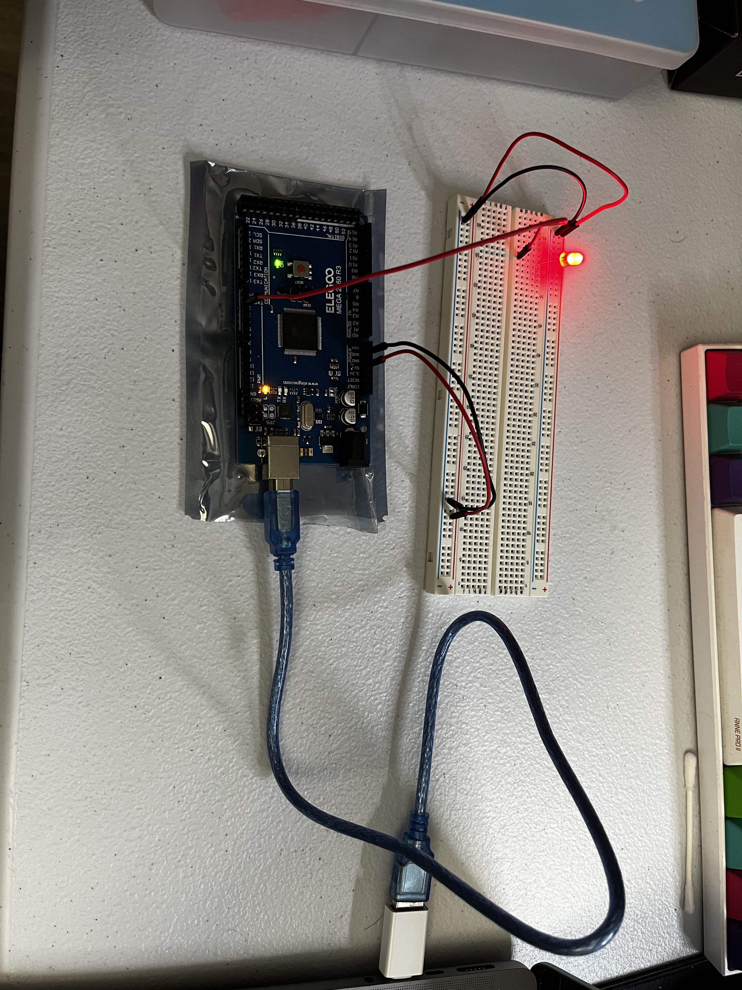
Circuit with red LED on

Slide 7
Serial Monitor

Slide 8
Circuit of door closed with Green LED ON

Slide 9
Circuit of door open with Green LED OFF

Slide 10
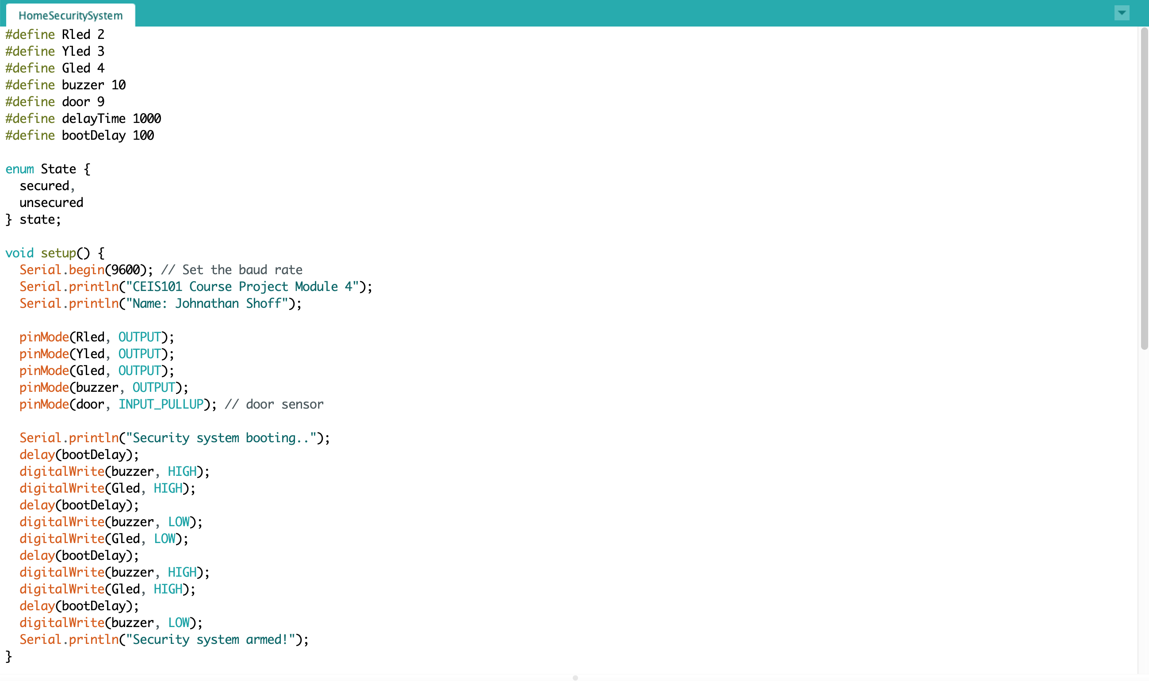
Arduino Setup Code

Slide 11
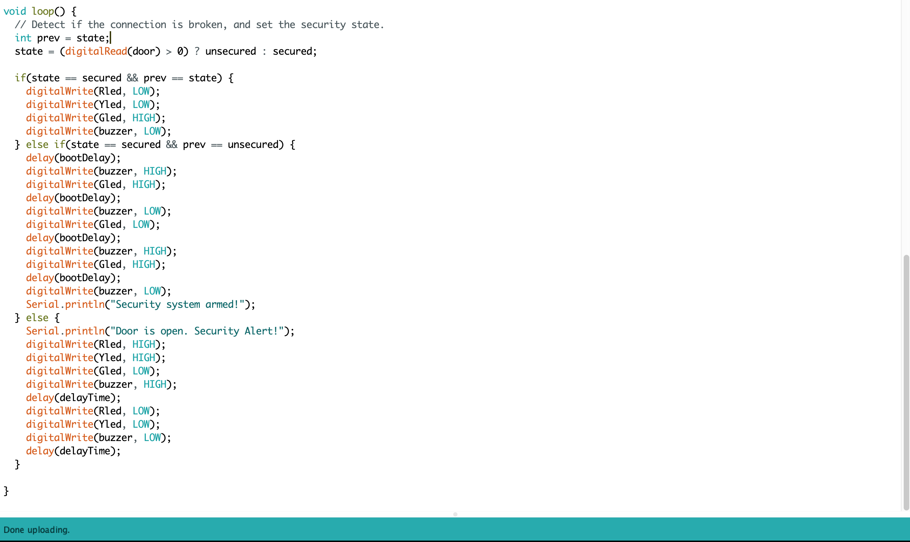
Arduino Loop Code

Slide 12
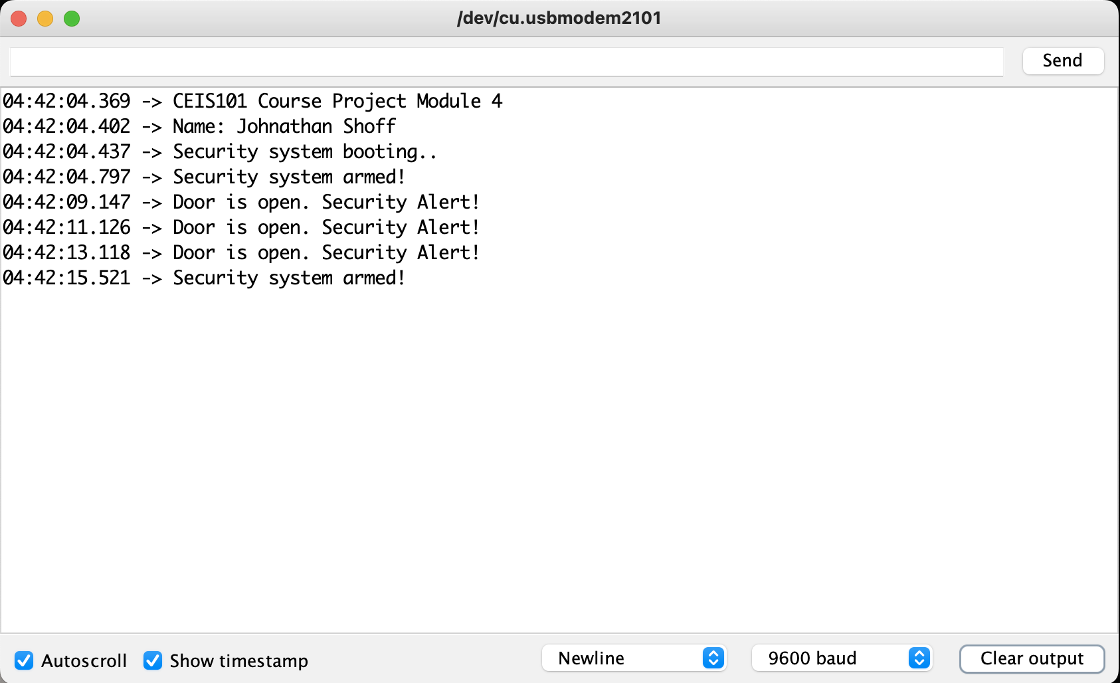
Serial Monitor

Slide 13
Circuit with green LED on

Slide 14
Circuit with yellow LED on

Slide 15
Circuit with red LED on

Slide 16
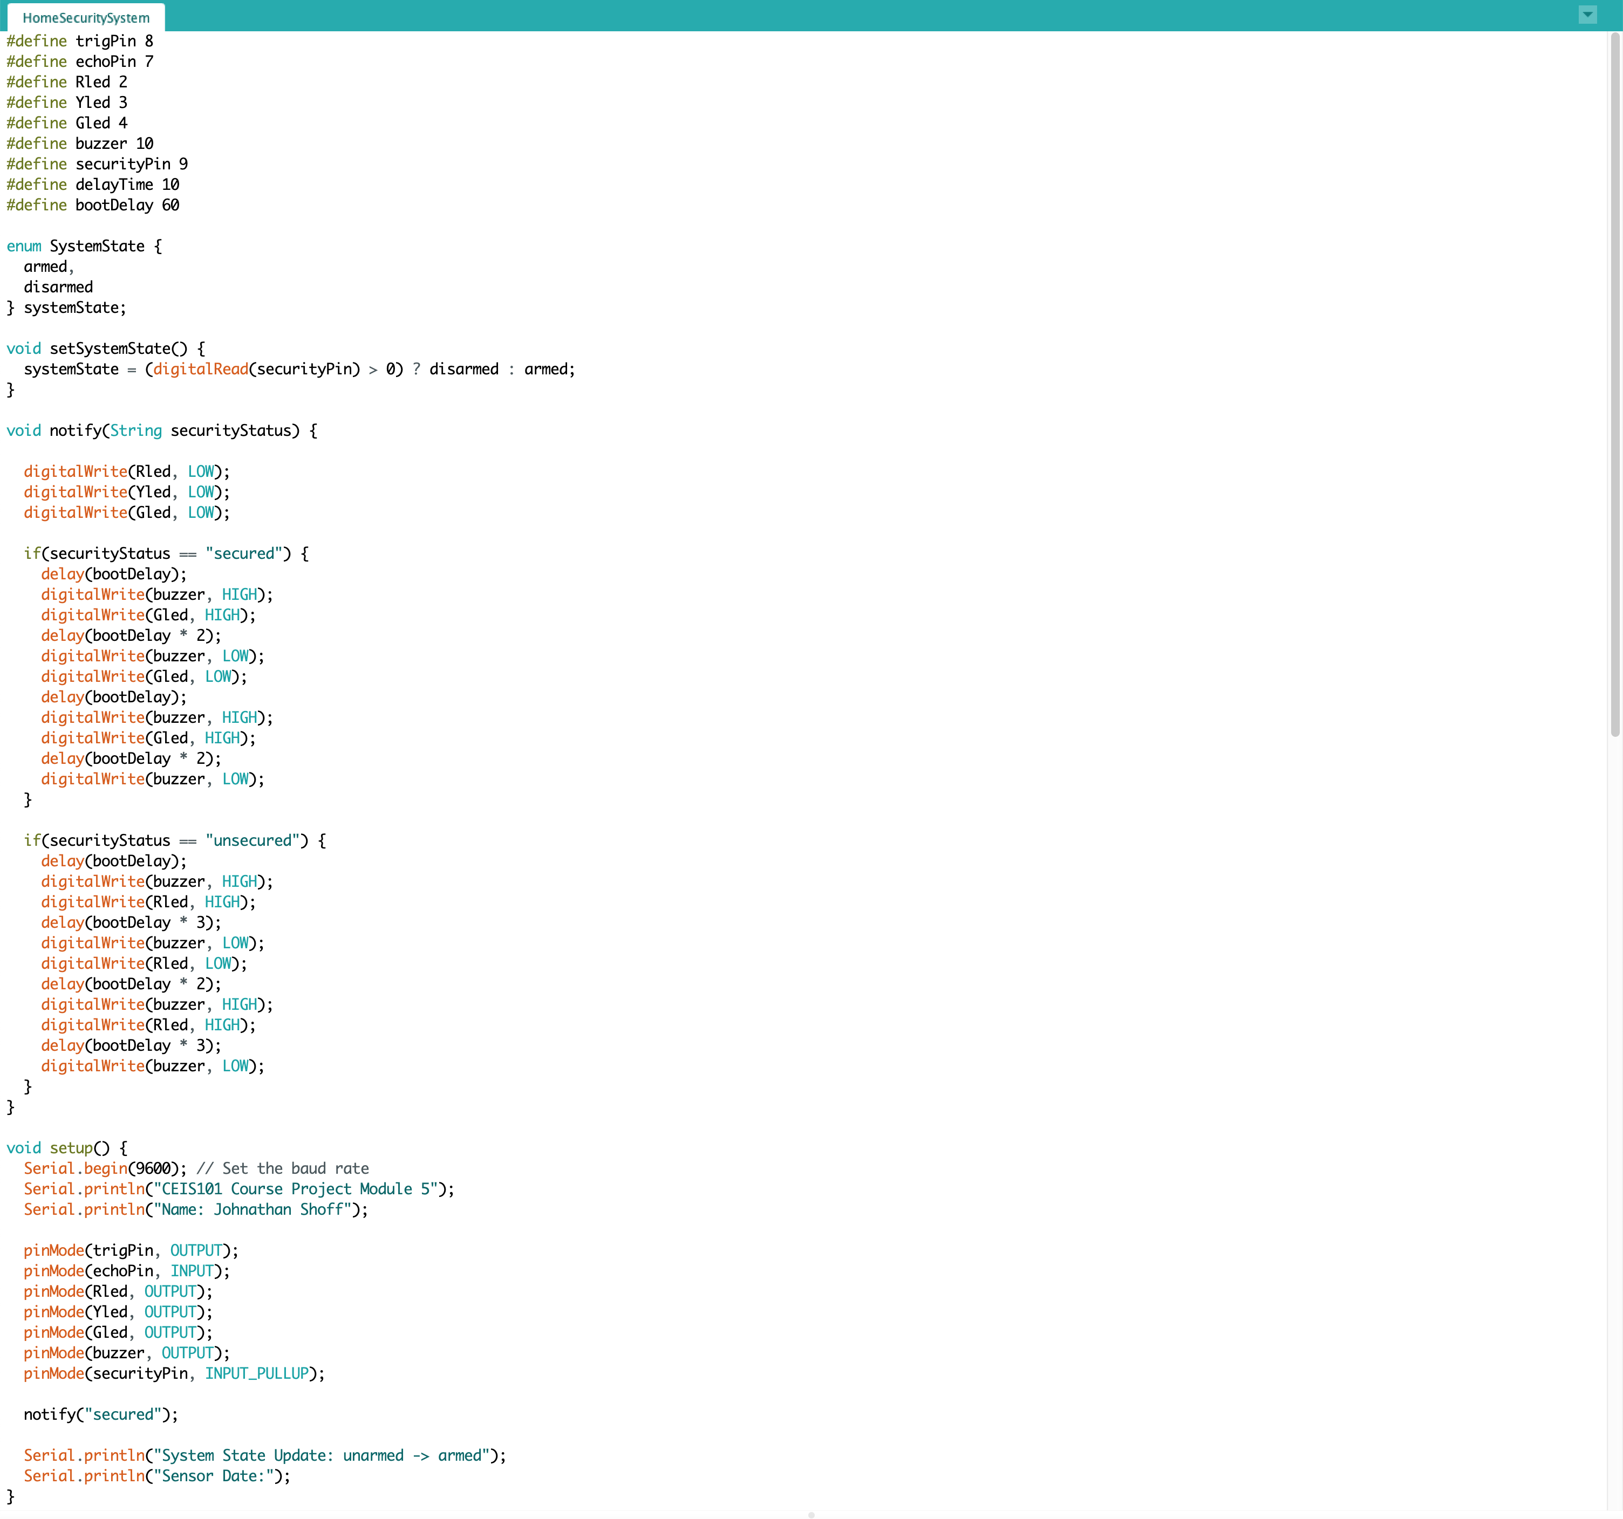
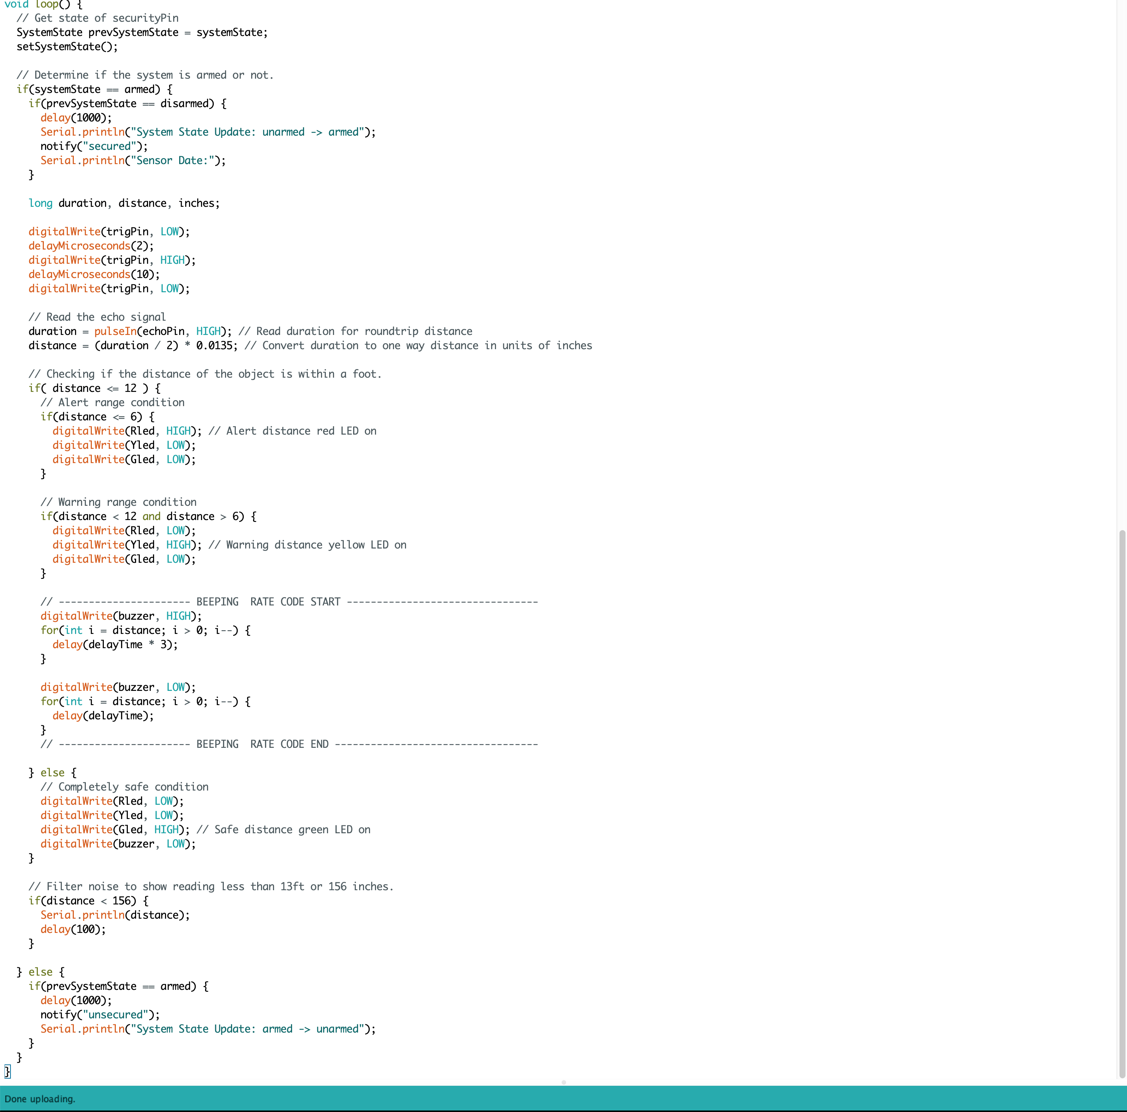
Arduino Code

Slide 17
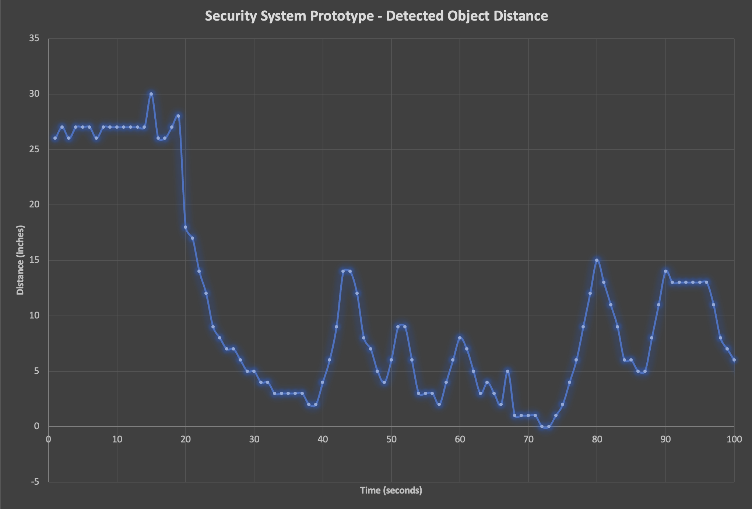
Scatter Plot of Distance Sensor Data

Slide 18
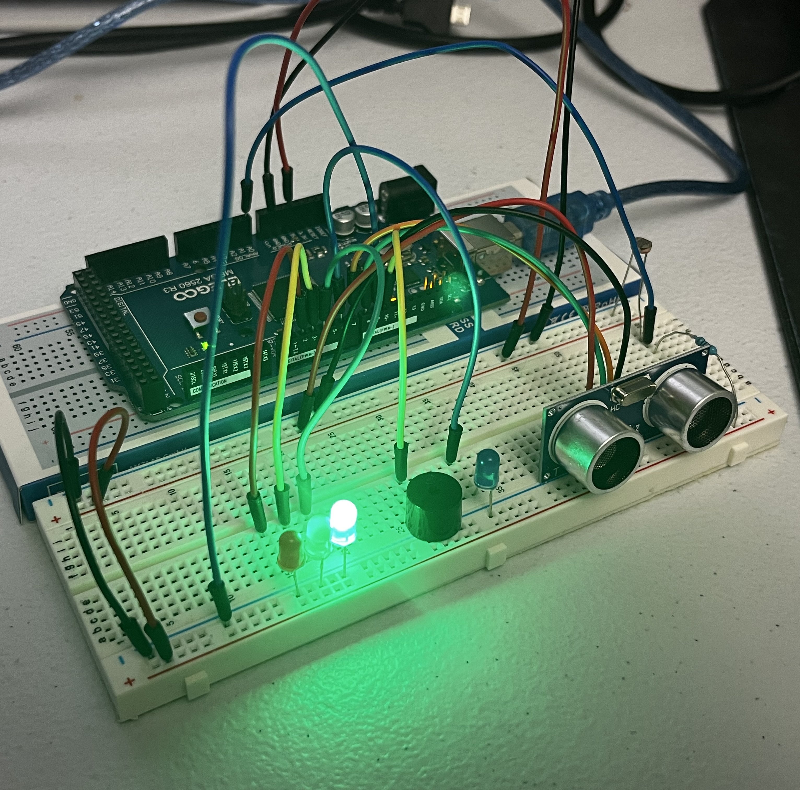
Circuit with automated LED off

Slide 19
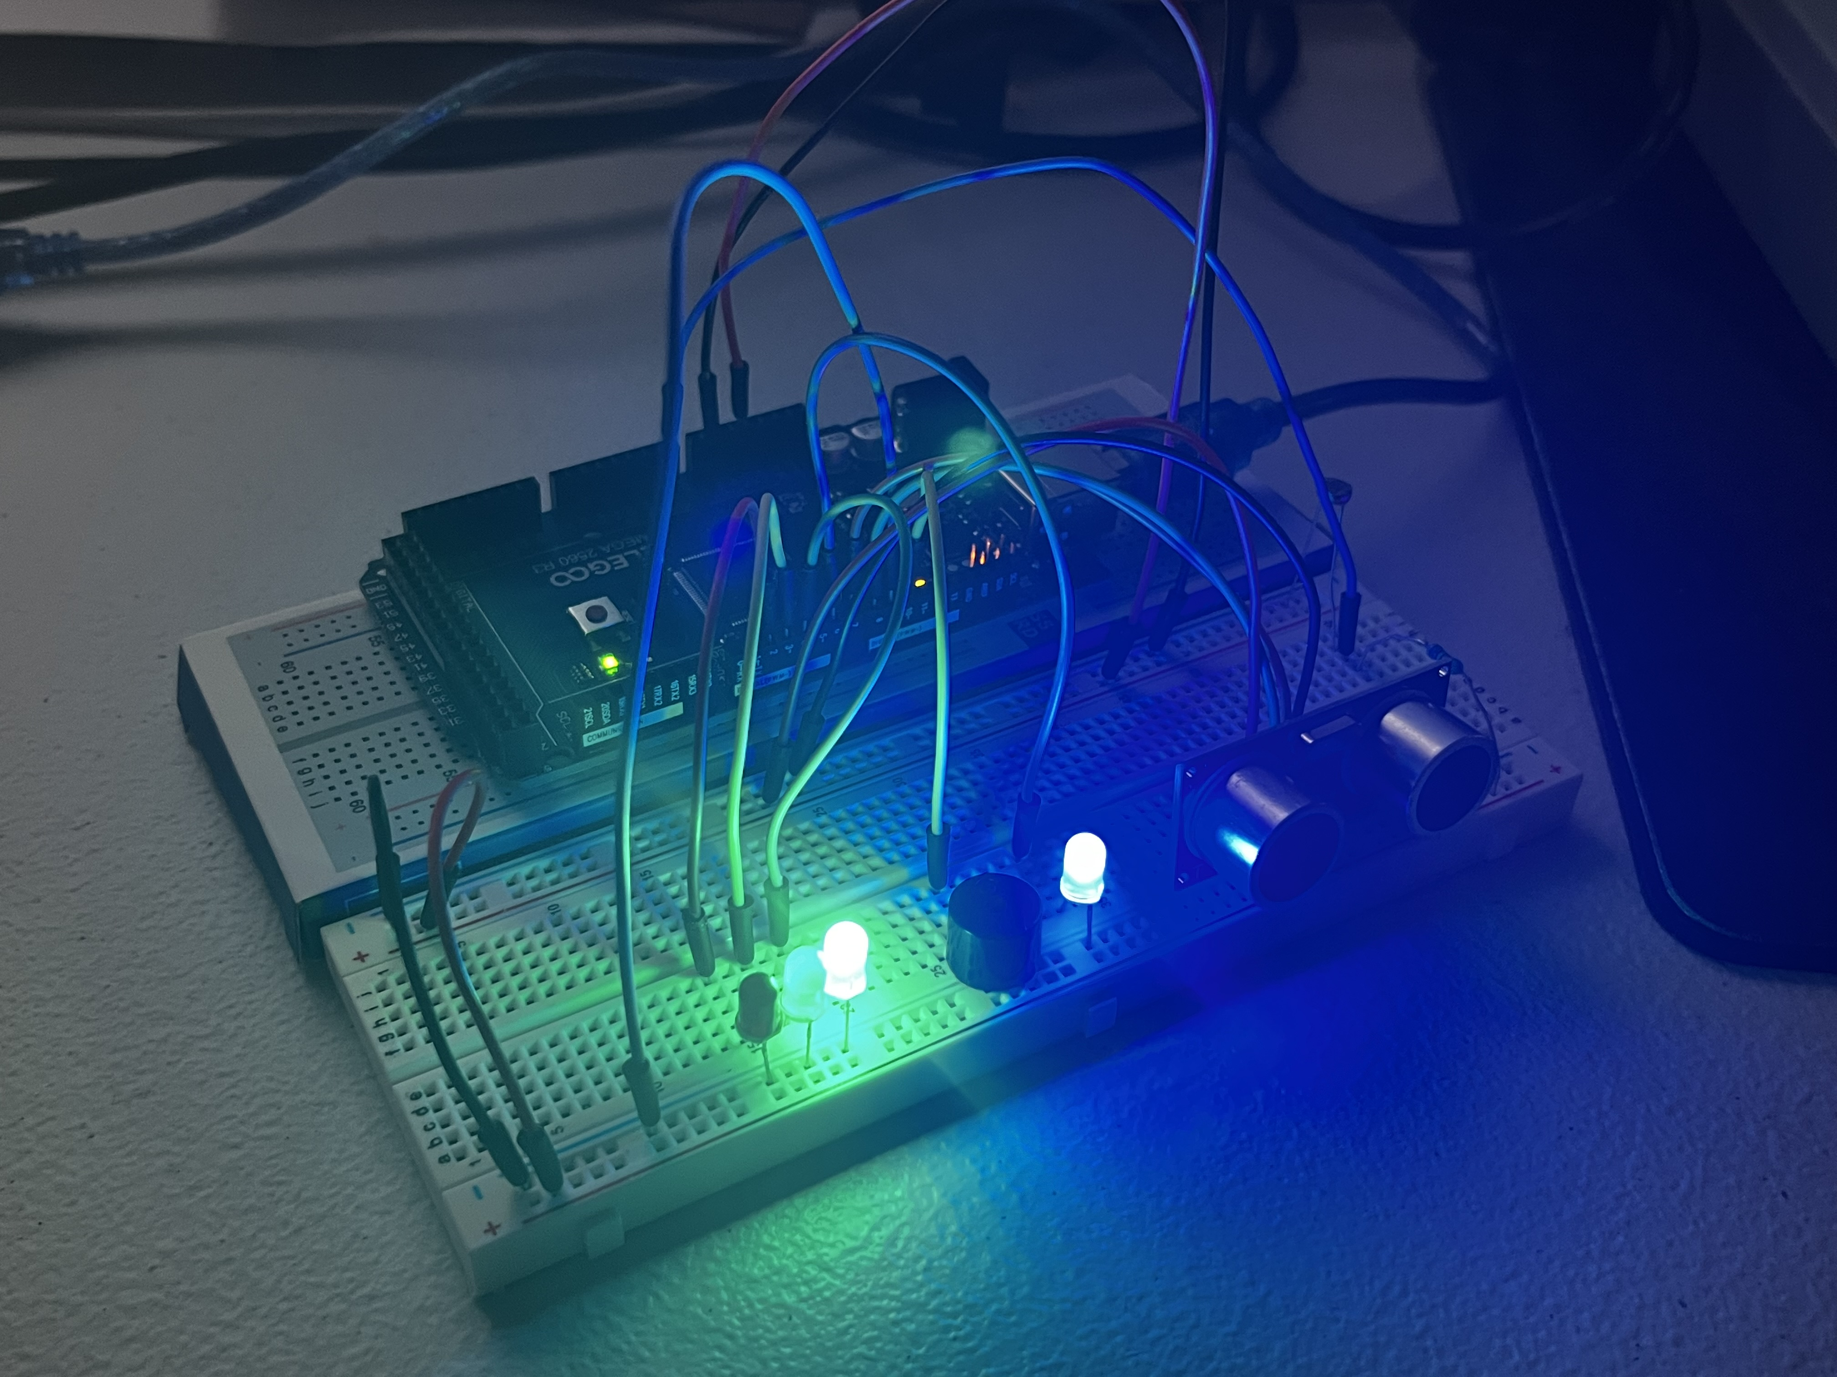
Circuit with automated LED on

Slide 20
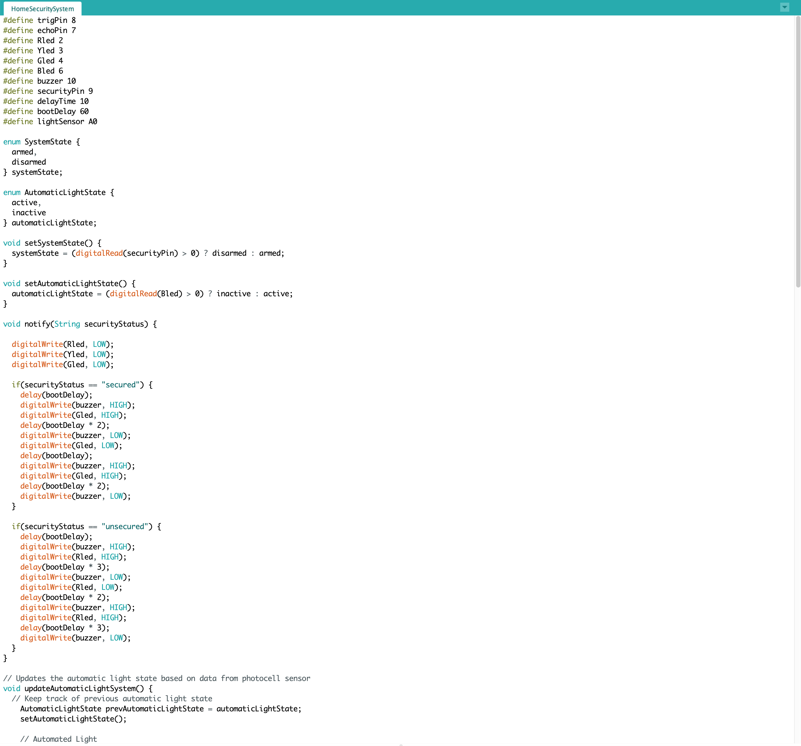
Arduino Code – Part 1

Slide 21
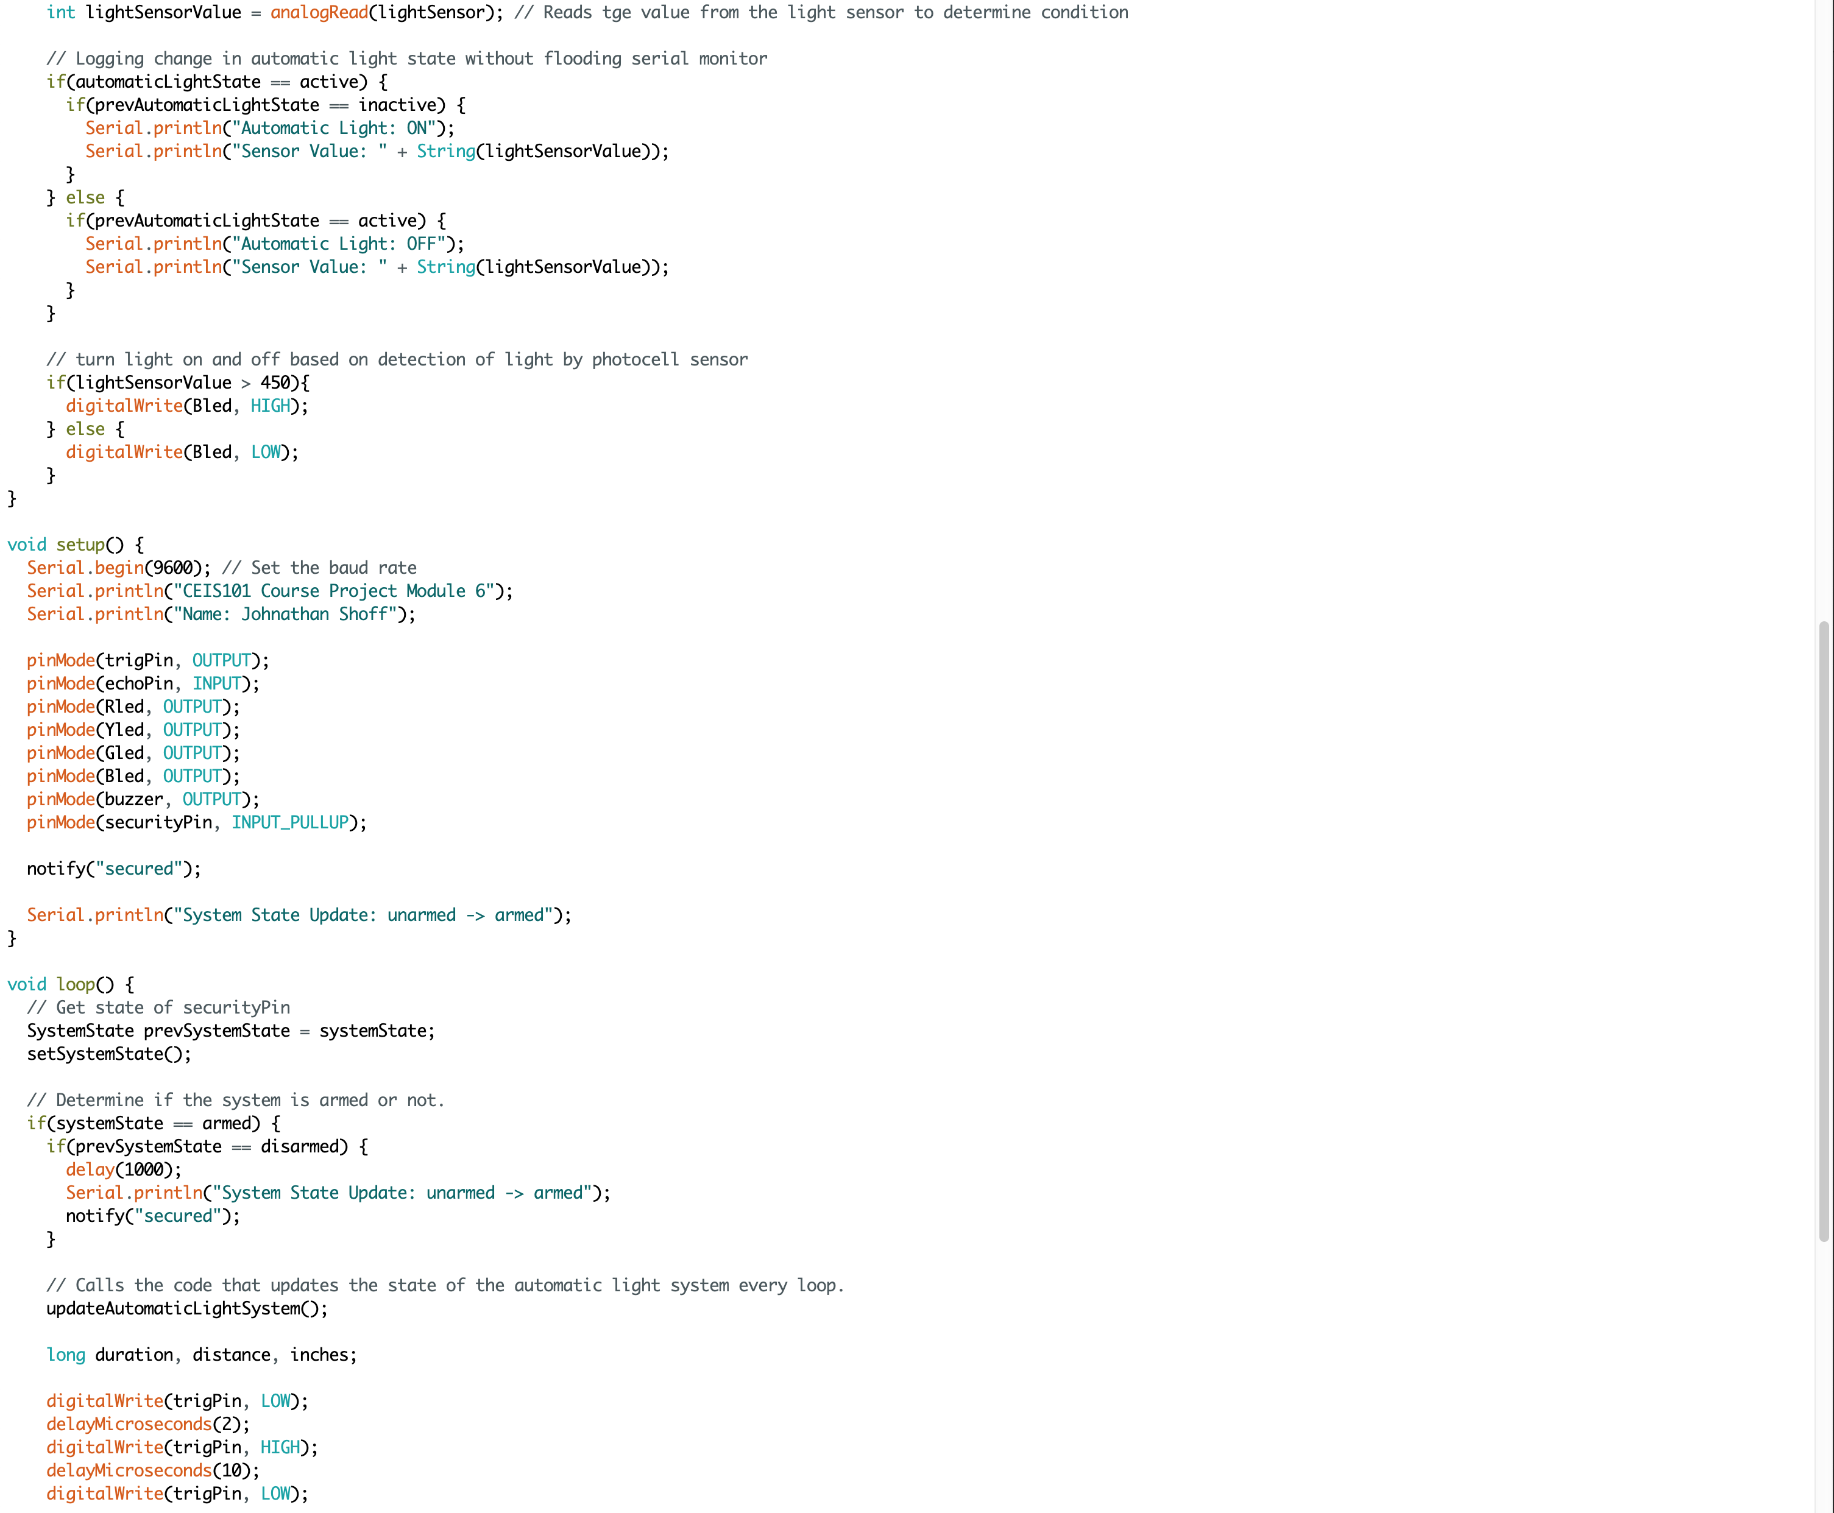
Arduino Code – Part 2

Slide 22
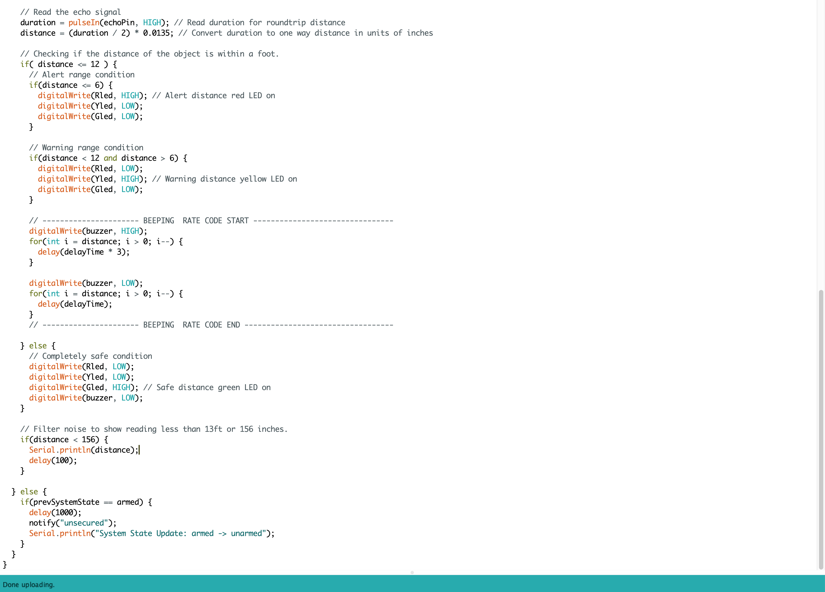
Arduino Code – Part 3

Slide 23
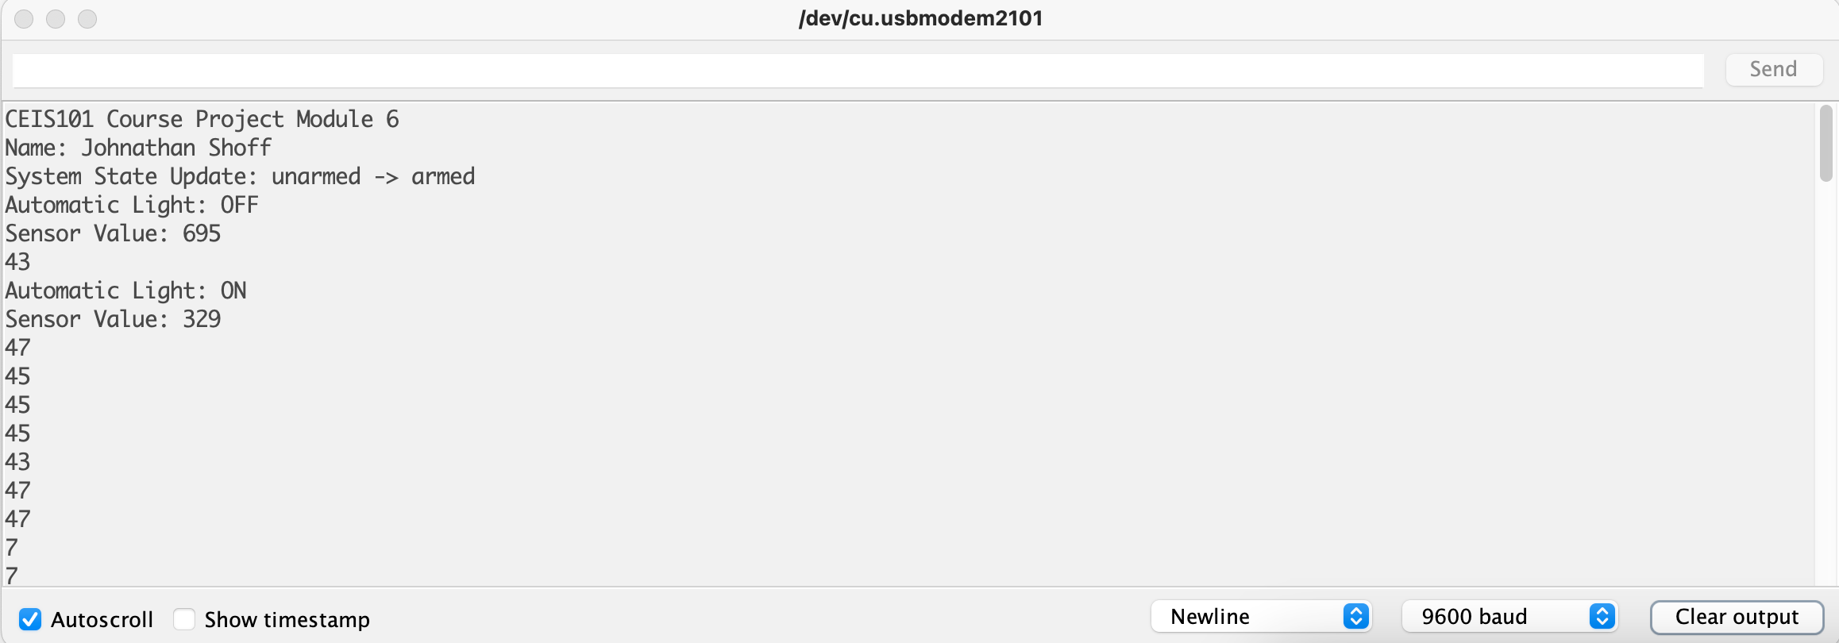
Serial Monitor

Slide 24
Challenges during the Project
During the project one of the biggest challenges was making sure that the various components and wires were being connected correctly.
During the beginning of the project, I took apart the assembly not realizing that I would need to build upon it each week.
I faced some challenges figuring out how I could improve the code logic driving the home security system prototype.

Slide 25
Skills acquired during this course
I learned how to user an Arduino board.
I learned how to work with the Arduino code editor.
I learned how to send and read signals using code.
I learned how to wire up various components correctly.
I learned how pairing on various components would allow for an input and feedback system.
Lastly, I was able to really push my programming around Arduino, and IoT.

Slide 26
Conclusion of the course
During the course we learned about putting components together to create complex systems. We learned how to use code to tell the components how they should behave based on various actions. It was a lot of hands-on fun working with the Arduino Mega board and coding the various functionalities. I would recommend anyone looking to get a real hands-on experience working with IoT components and coding them to check out the CEIS101 course at DeVry University. It was so much fun, and I looked forward to expanding my code every week.

